Slide 1
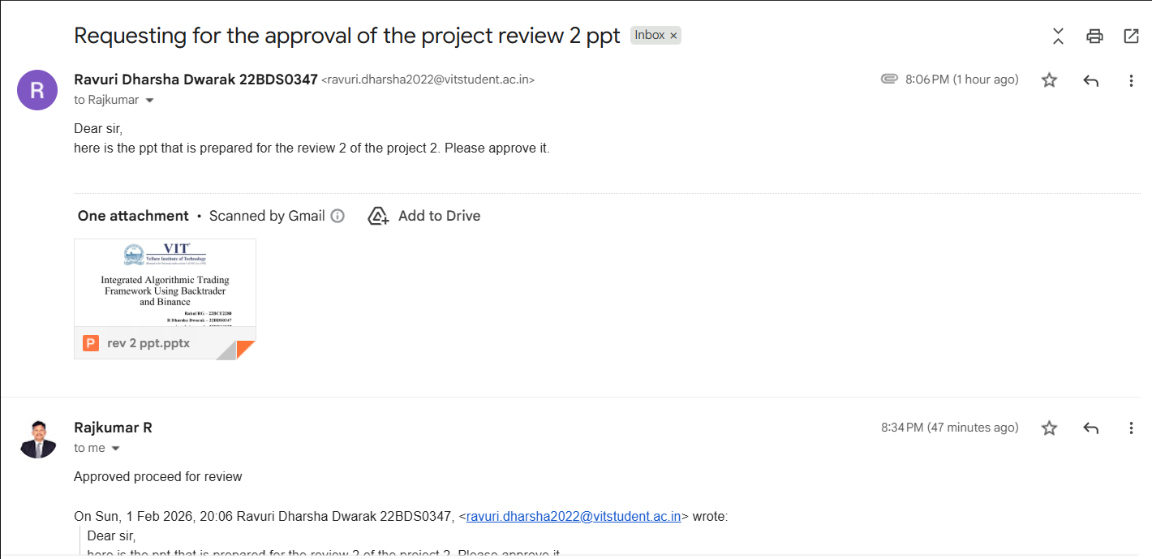

Slide 2

Integrated Algorithmic Trading Framework Using Backtrader and Binance
Rahul RG – 22BCE2280
R Dharsha Dwarak – 22BDS0347
Ayush Agarwal – 22BDS0337

Slide 3
Introduction
Financial markets generate massive volumes of price data every second
Human trading decisions are often influenced by emotion, bias, and reaction delay
Quantitative trading uses rule-based, data-driven models to remove these factors
Decisions are derived from historical price behavior and statistical relationships
Strategy performance is measured relative to gold, not USD
Gold is treated as the base asset to reflect real value creation beyond inflation

Slide 4
Problem Statement
Although quantitative trading is systematic, designing an effective trading system is non-trivial
Key challenges include:
Translating raw historical price data into reliable trading signals
Verifying true profitability before live deployment
Many existing approaches lack rigorous historical validation
There is a need for a structured quantitative trading framework
The framework must be objectively tested using out-of-sample historical data before live trading

Slide 5
RESARCH GAP
Many studies do not provide complete end-to-end trading frameworks
Historical backtesting is often insufficient or missing
Out-of-sample testing is frequently ignored
Fair comparison of models under identical conditions is lacking
Risk-adjusted performance metrics are commonly ignored
Transaction costs and leverage are rarely considered
Performance is typically reported in USD rather than relative to gold
This obscures real value creation and inflation-adjusted profitability

Slide 6
Research Objectives
Analyze historical market price data to understand price behavior
Develop a structured quantitative trading framework
Generate rule-based entry and exit signals
Perform rigorous historical and out-of-sample backtesting
Evaluate performance using objective and risk-adjusted metrics
Benchmark returns relative to gold instead of USD
Assess robustness and feasibility of fully systematic trading

Slide 7
Proposed System Overview
The system uses historical price data as the primary input
Market behavior is captured through patterns and indicators derived from raw prices
Quantitative models generate rule-based entry and exit signals
Signals are evaluated through historical and out-of-sample testing
Strategy effectiveness is measured using objective performance metrics
Performance is benchmarked relative to gold, treating gold as the base asset rather than fiat currency

Slide 8
System Diagram
Historical Data (CSV/API)
Feature Engineering (Pandas/Numpy)
Prediction Model (PyTorch)
Backtesting & Performance
Binance API Execution
Decision Logic (Trade signals)

Slide 9
Modules List
Data Loader
Feature Engineering
Prediction Models
Backtesting and output

Slide 10
Module — Data Loader
Read time-series OHLC CSV (BTC data).
Handle missing data and timestamp alignment.
Normalize/scale features for models.
Module — Feature Engineering
Create technical indicators: SMA, EMA, RSI (optional).
Combine into model input vectors.
Helps model capture trends before prediction.

Slide 11
Module — Prediction Model
Build different models such as linear, non-linear, and neural network
Linear Model:
Assumes a direct linear relationship between historical price features and the output.
Uses past price values and derived indicators as input features.
Learns fixed weights to generate price movement or trading signals.
Acts as a baseline model for comparison with complex approaches.

Slide 12
Non-linear Model:
Allows non-linear relationships between input features and predictions.
Applies non-linear transformations to capture complex market behavior.
Models interactions between price features that linear models cannot.
Provides improved flexibility while remaining relatively lightweight.
Neural Network:
Composed of multiple layers of interconnected neurons.
Learns complex and hierarchical patterns form historical market data.
Handles highly non-linear and dynamic price movements.
Offers the highest modeling capacity among the three approaches.
Now compare all three of them using equity curve comparison

Slide 13
Module — Backtesting & Research
Module — Trade Exexution
Use Binance.py to connect to API
Live or paper trading.
Place market/limit orders.
Example:
client.order_market_buy(symbol="BTCUSDT", quantity=0.001)
Run research,py to simulate strategies.
Compare buy/sell decisions against historical prices.
Metrics: Return %, Sharpe ratio (optional), drawdowns.

Slide 14
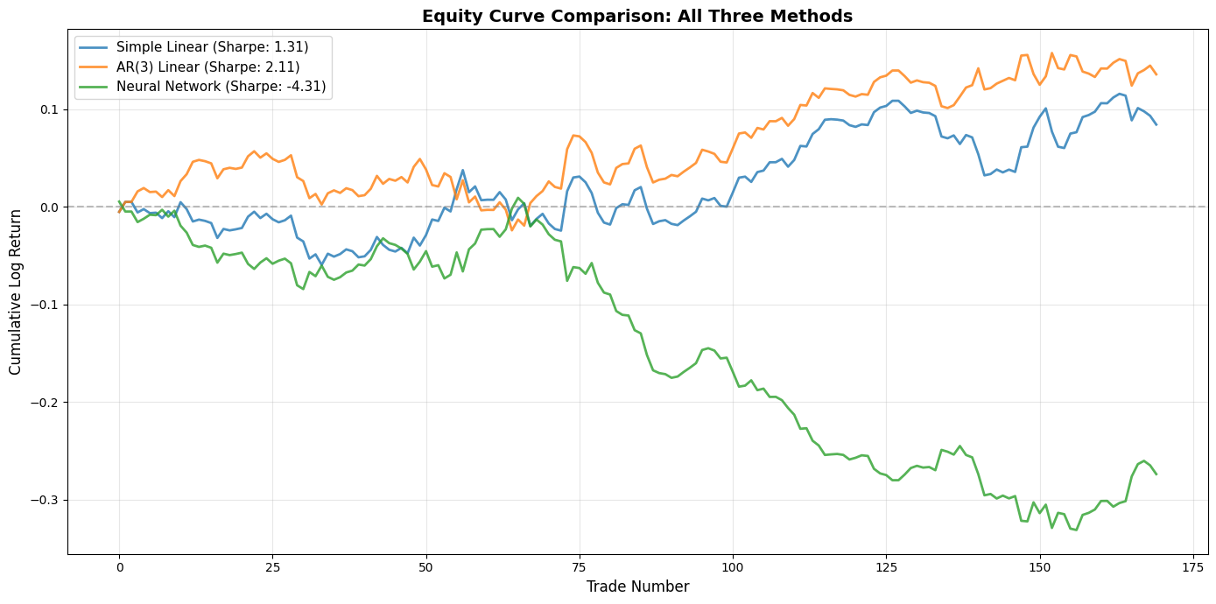
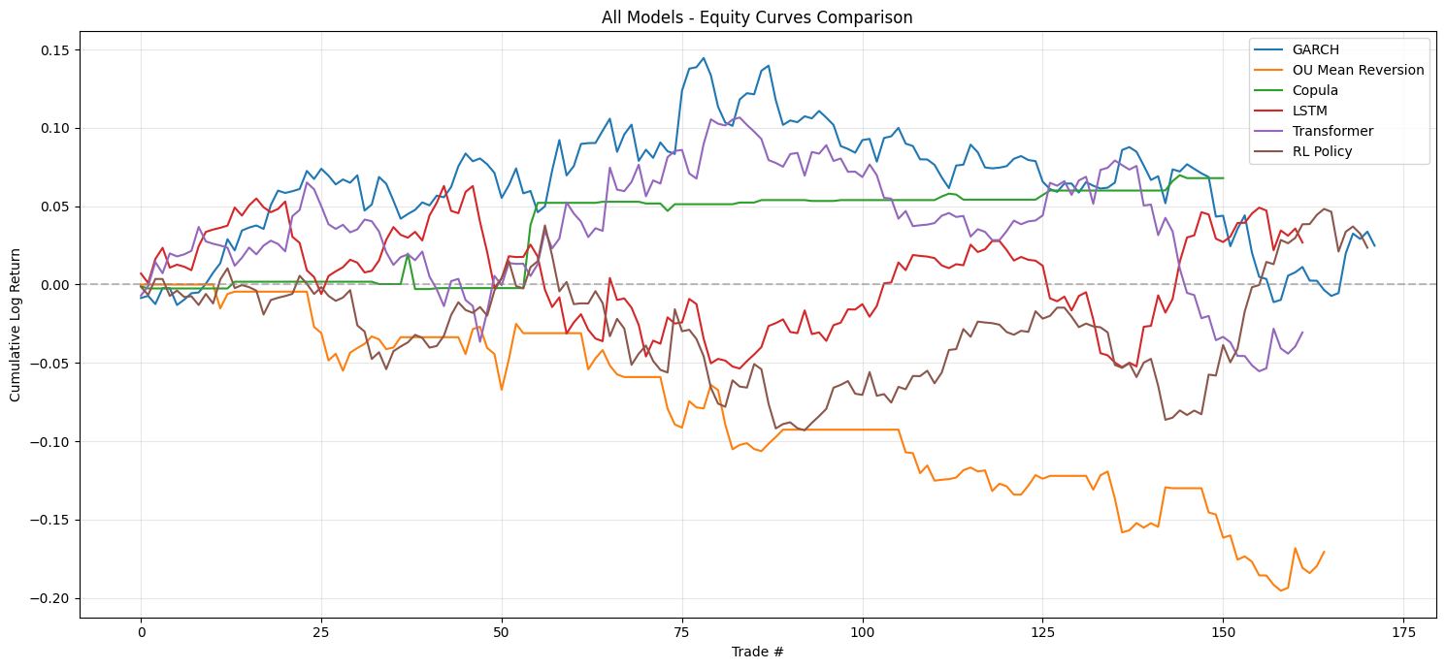
Implementation Results
Simple Linear: 8.78%
AR(3) Linear: 14.52%
Neural Network: -24.98
Deep RL Policy: Return=2.71%
Transformer: Return= - 4.42%
Copula Mispricing: Return=7.03%
GARCH Volatility Regime: Return=2.51%
LSTM Neural Network: Return=2.72%
OU Mean Reversion: Return= -15.3%

Slide 15
Summary & Next Steps
Designed a quantitative decision-making framework to generate entry and exit trading signals using historical market data.
Implemented a fully automated data → model → trade pipeline.
Evaluated signal effectiveness using systematic backtesting and risk-adjusted performance metrics.
Analyzed strategy performance against Gold, using comparative plots to account for macro effects and avoid misleading USD-denominated returns.
Demonstrated that data-driven trading decisions are more consistent and objective than manual approaches.

Slide 16
REFERENCES
[1] Mnih, V., et al., “Human-level control through deep reinforcement learning,” Nature, vol. 518, no. 7540, pp. 529–533, 2015.
[2] Moody, J., & Saffell, M., “Learning to trade via direct reinforcement,” IEEE Transactions on Neural Networks, vol. 12, no. 4, pp. 875–889, 2001.
[3] Deng, Y., Bao, F., Kong, Y., Ren, Z., & Dai, Q., “Deep direct reinforcement learning for financial signal representation and trading,” IEEE Transactions on Neural Networks and Learning Systems, vol. 28, no. 3, pp. 653–664, 2017.
[4] Salih, A., et al., “A survey on artificial intelligence, machine learning, and deep learning for cybersecurity,” Proceedings of the IEEE International Engineering Conference, pp. 61–66, 2021.
[5] Silver, D., et al., “Mastering the game of Go with deep neural networks and tree search,” Nature, vol. 529, pp. 484–489, 2016.
[6] OpenAI, “Proximal policy optimization algorithms,” arXiv preprint arXiv:1707.06347, 2017.

Slide 17
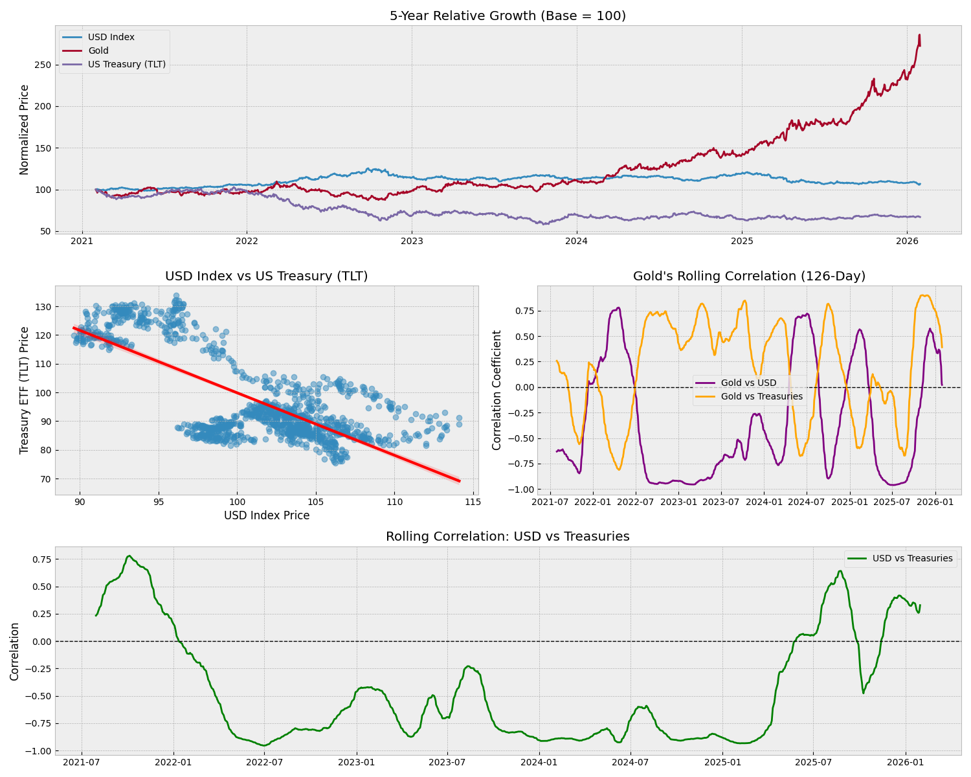
Treasury rates vs Gold

